Slide 1
Big Data Project
Market basket analysis

Slide 2
Instacart competition
American company that operates as a same-day grocery delivery service
Kaggle competition – a sample dataset of over 3 million grocery orders from more than 200,000 Instacart users. The orders include 32 million basket items and 50,000 unique pro
objective = predict which previously purchased products will be in a user’s next order

Slide 3
Problem definition
Each order in the data labelled as prior, train or test
Prior orders describe the past behaviour of a user while train and test orders regard the future behaviour that we need to predict
This is a classification problem because we need to predict whether each pair of user and product is a reorder or not. This is indicated by the value of the reordered variable (0 or 1)

Slide 4
Methods
1. import data
2. create predictor variables
3. create train and test DF
4. create predictive model
5. apply predictive model

Slide 5
1. Import data

Slide 6
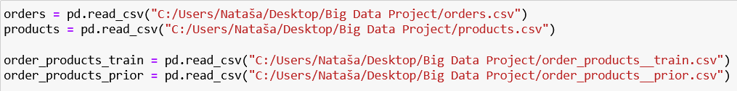
Load datasets

Slide 7
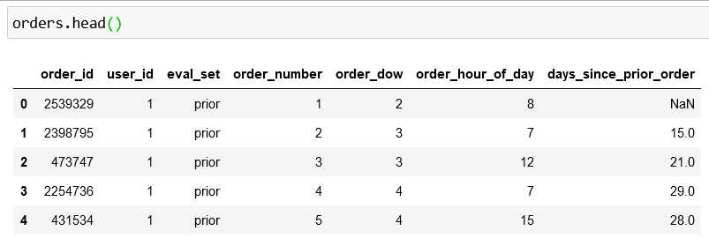
Preview datasets (1)

Slide 8
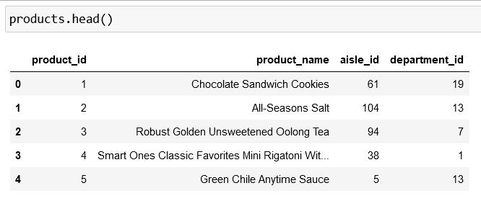
Preview datasets (2)

Slide 9
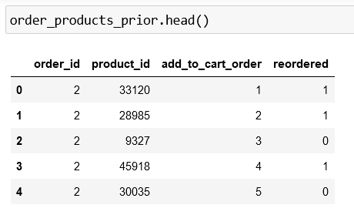
Preview datasets (3)

Slide 10
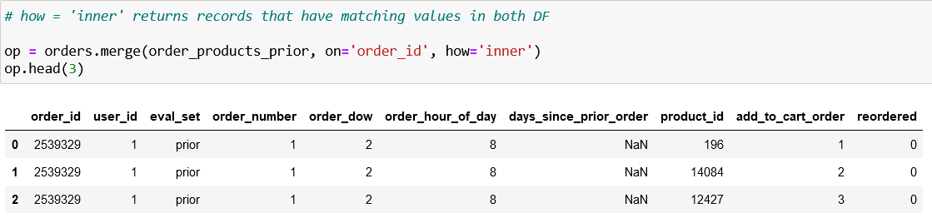
Create new DF – op
With the orders and the products that have been purchased on prior orders
Will use it for the predictor variables

Slide 11
2. Create predictor variables
User predictors
Product predictors
User-PRODUCT PREDICTORS

Slide 12
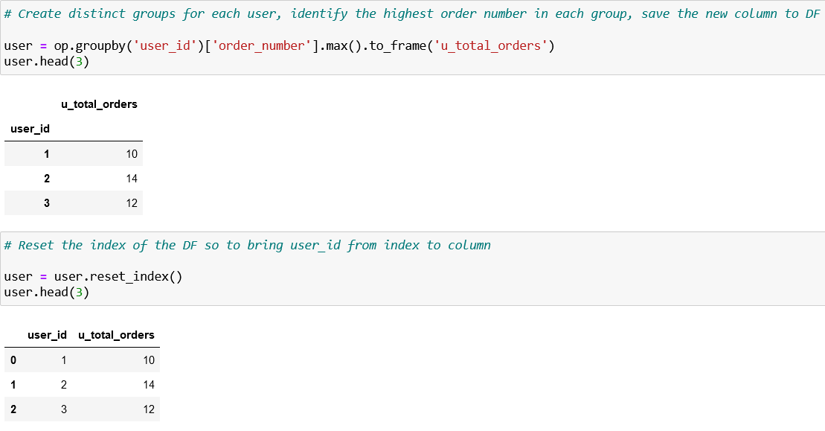
User - Number of orders per customer

Slide 13
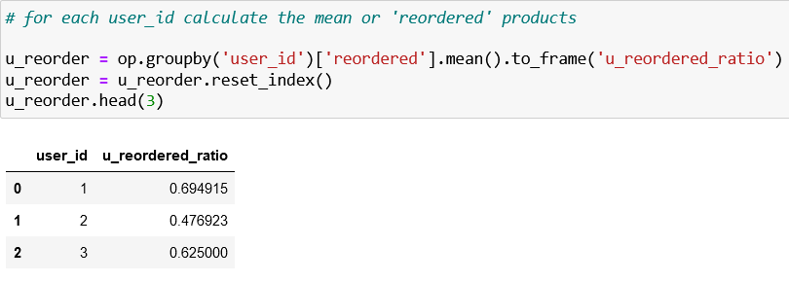
User - How frequent a customer has reordered products (1)

Slide 14
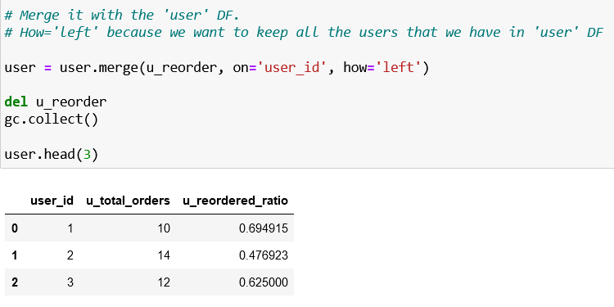
User - How frequent a customer has reordered products (2)
Merge it with user

Slide 15
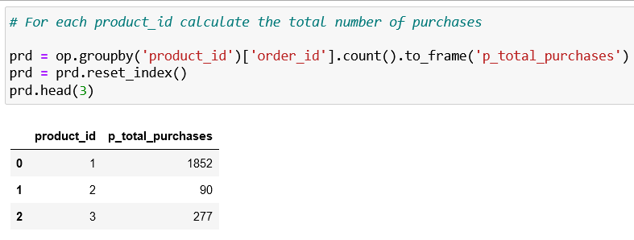
Product - Number of purchases for each product

Slide 16
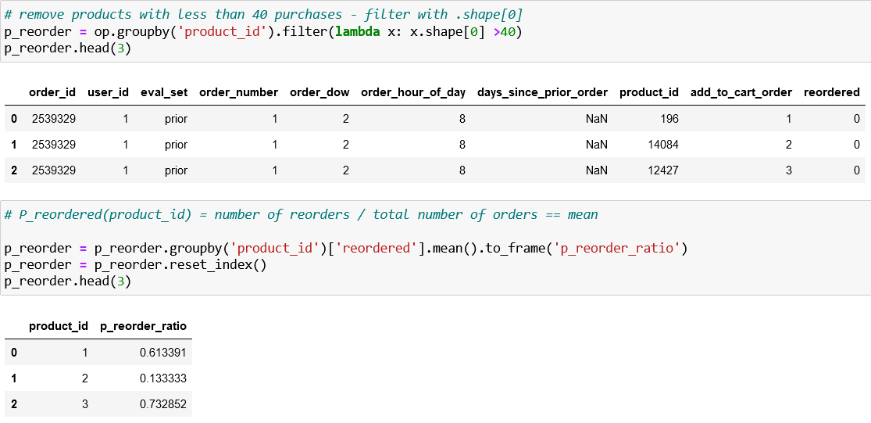
Product - Probability of a product to be reordered (1)

Slide 17
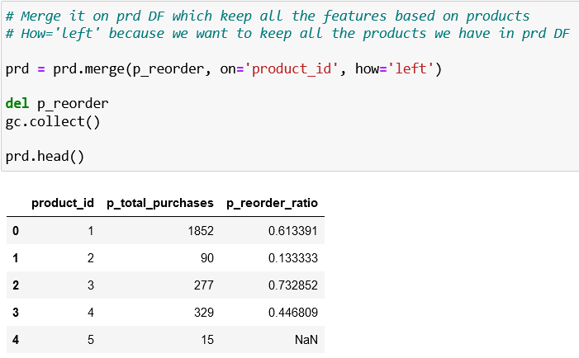
Product - Probability of a product to be reordered (2)
Merge it with prd

Slide 18
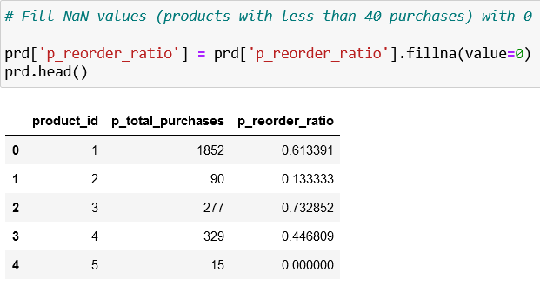
Product - Probability of a product to be reordered (3)
Fill NaN values

Slide 19
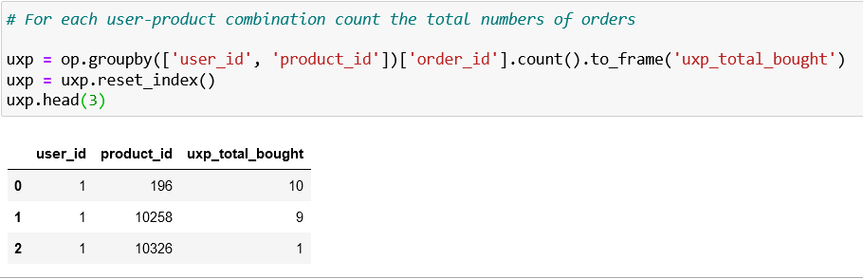
User-product - How many times a user brought a product

Slide 20
User-product - How frequently a customer brought a product after its first purchase (1)
P_reordered(user_id,product_id) = times_bought_N/order_range
times_bought_N = times user bought N
order_range = total orders placed since the first user's order of a product

Slide 21
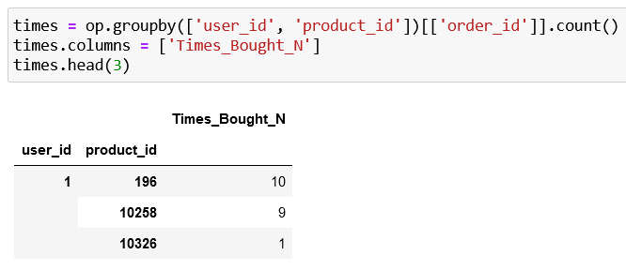
User-product - How frequently a customer brought a product after its first purchase (2)
Times_bought_N

Slide 22
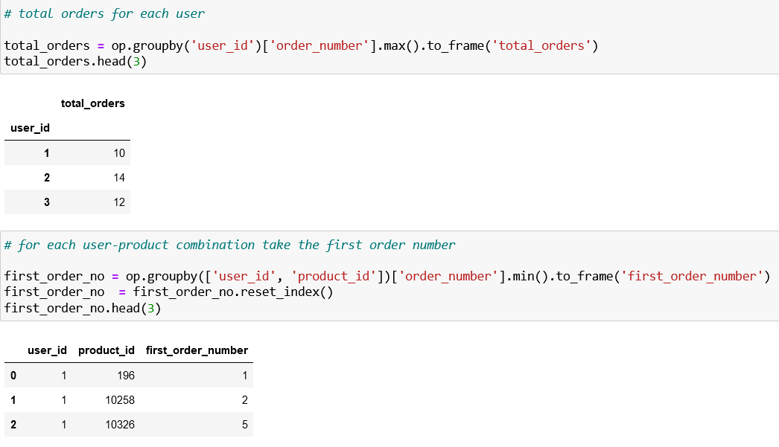
User-product - How frequently a customer brought a product after its first purchase (3)
Order range = total orders – first order + 1

Slide 23
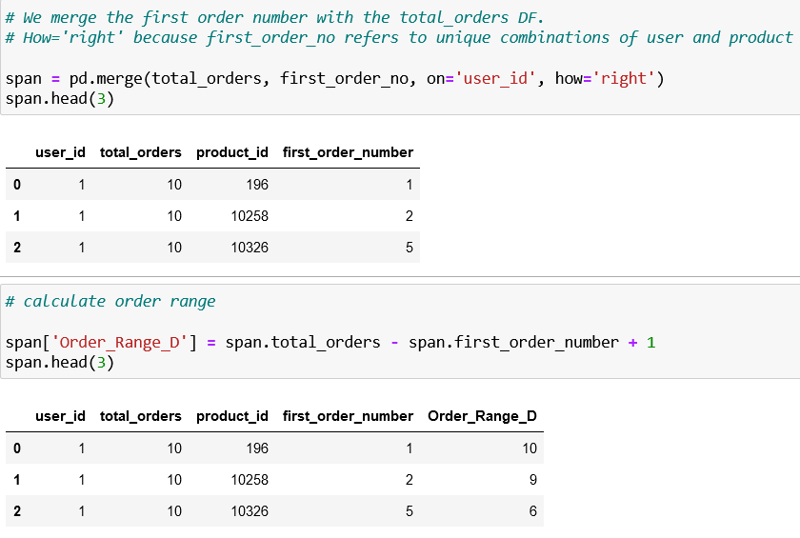
User-product - How frequently a customer brought a product after its first purchase (4)
Merge and calculate Order_range

Slide 24
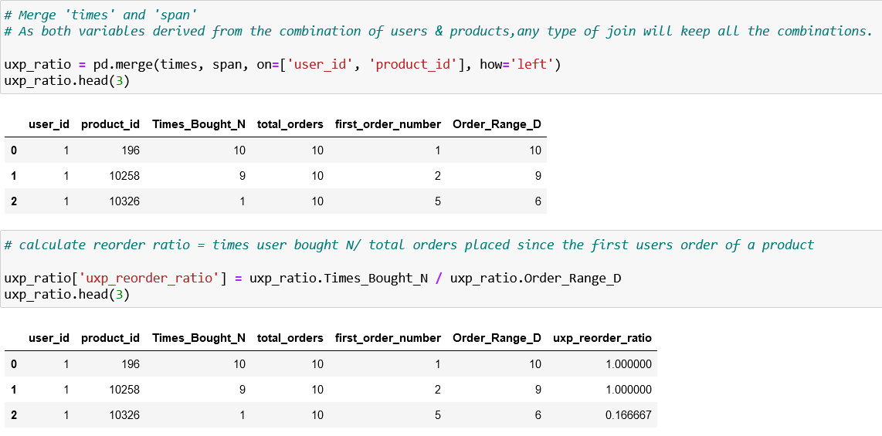
User-product - How frequently a customer brought a product after its first purchase (5)
Create final uxp_reorder_ratio

Slide 25
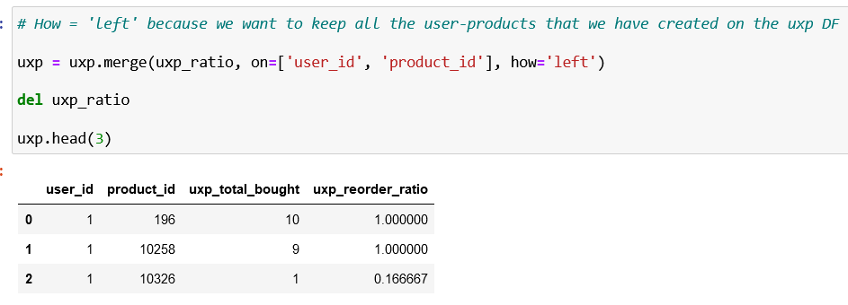
User-product - How frequently a customer brought a product after its first purchase (6)
Merge it with uxp

Slide 26
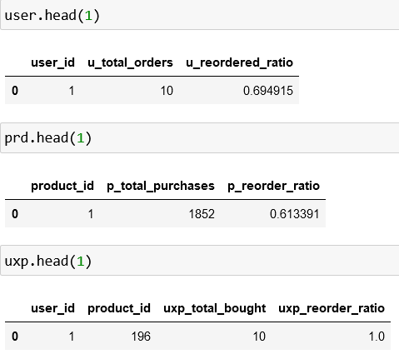
Merge all features (1)

Slide 27
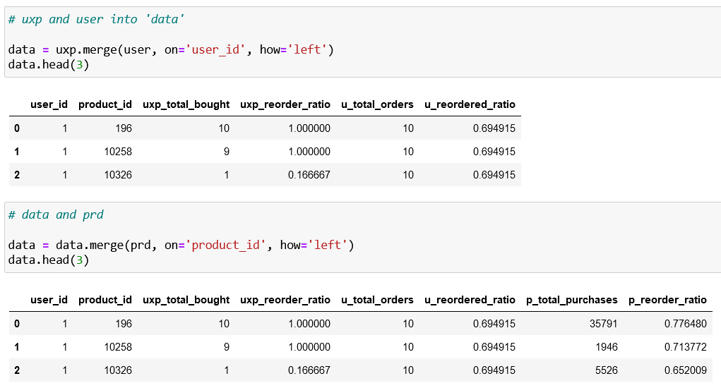
Merge all features (2)

Slide 28
3. Create train and test DF
PREparation
Train df
Test df

Slide 29
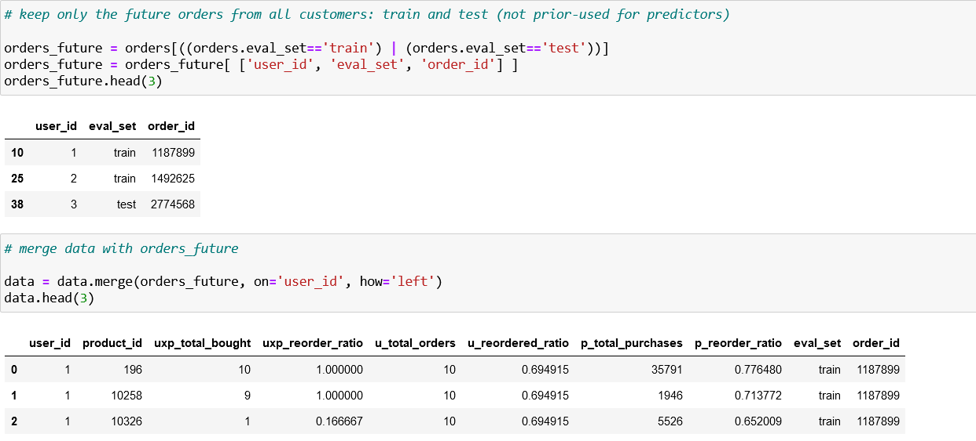
Preparation – use only future orders (not prior)

Slide 30
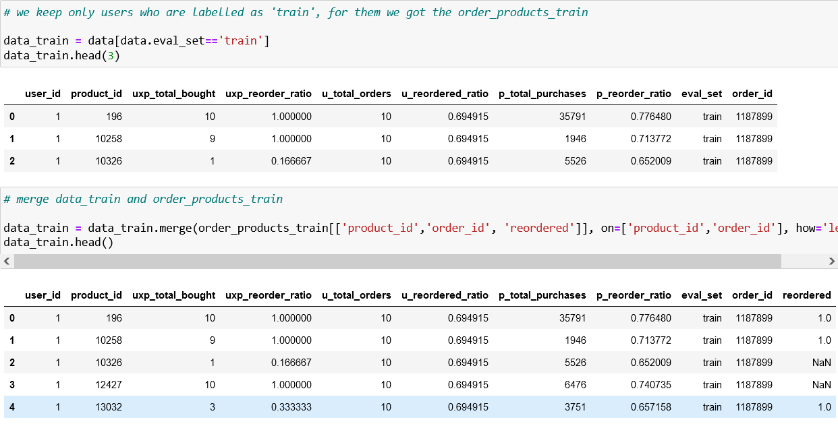
Create train DF (1)

Slide 31
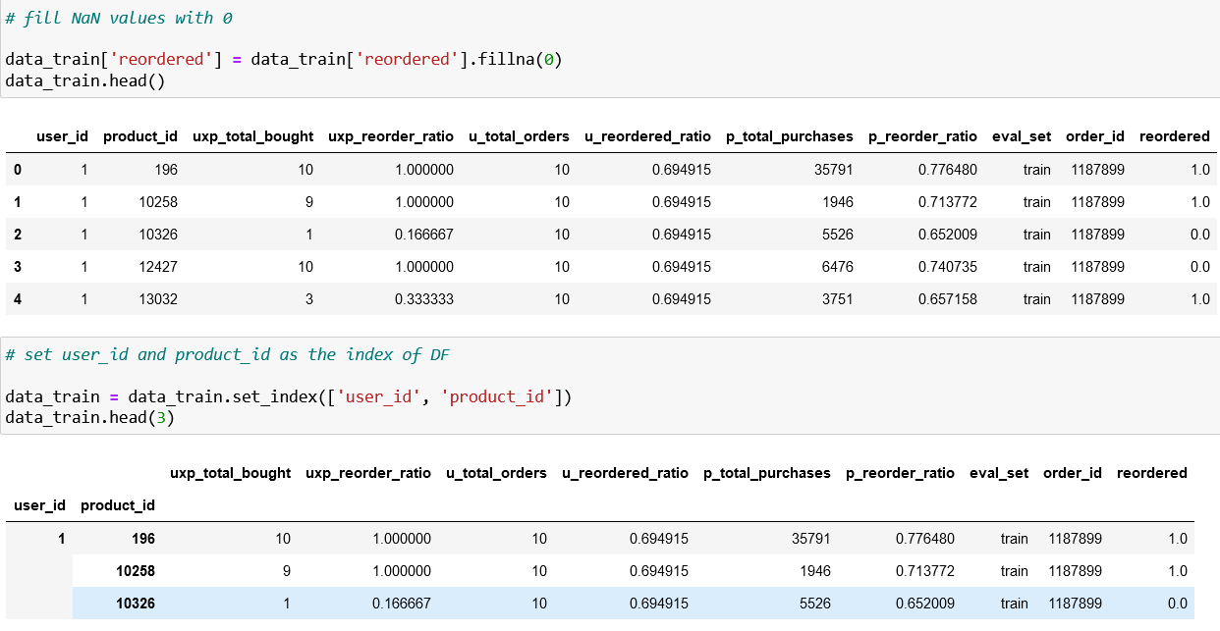
Create train DF (2)

Slide 32
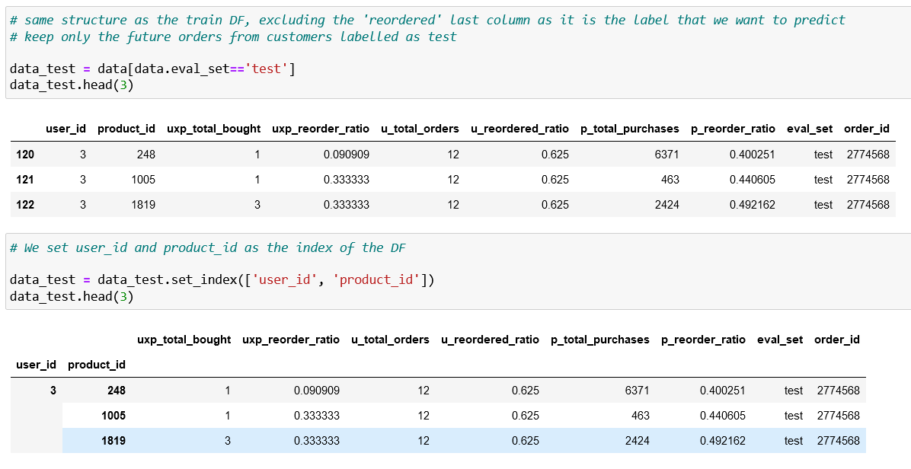
Create test DF

Slide 33
4. Create predictive model
XGBoost
Train XGB
evaluation

Slide 34
XGBoost
XGBoost stands for eXtreme Gradient Boosting, an algorithm that is used in many winning solutions for Kaggle competitions.
XGBoost is an implementation of gradient boosted decision trees designed for speed and performance.
Gradient boosting is an approach where new models are created that predict the residuals or errors of prior models and then added together to make the final prediction. It is called gradient boosting because it uses a gradient descent algorithm to minimize the loss when adding new models.

Slide 35
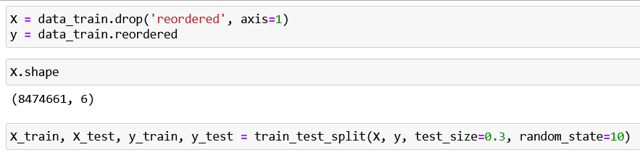
TRAIN XGB (1)

Slide 36
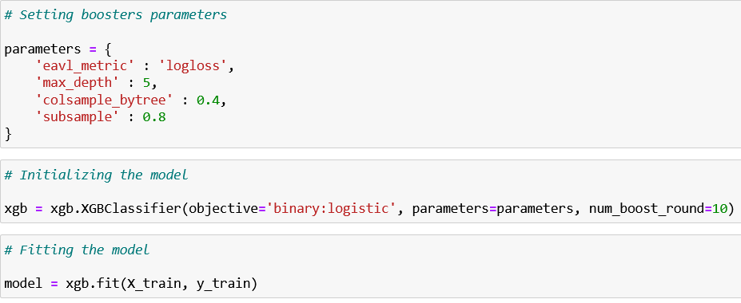
TRAIN XGB (2)

Slide 37
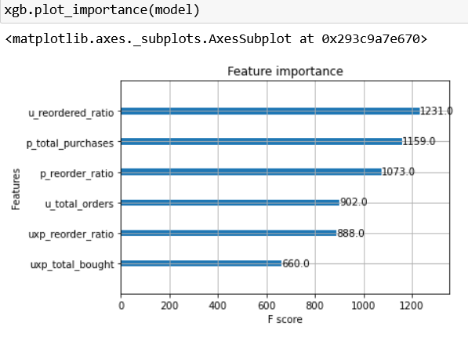
TRAIN XGB (3)

Slide 38
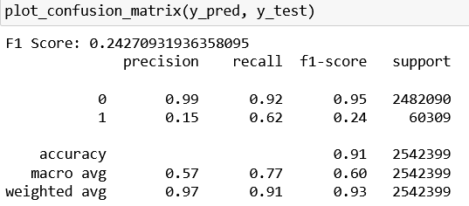
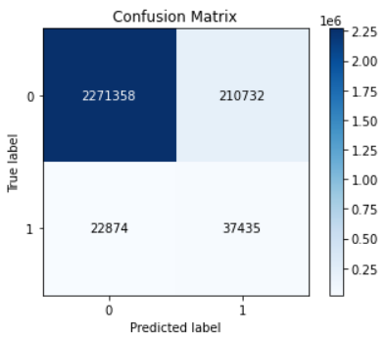
Evaluation

Slide 39
5. Apply predictive model

Slide 40
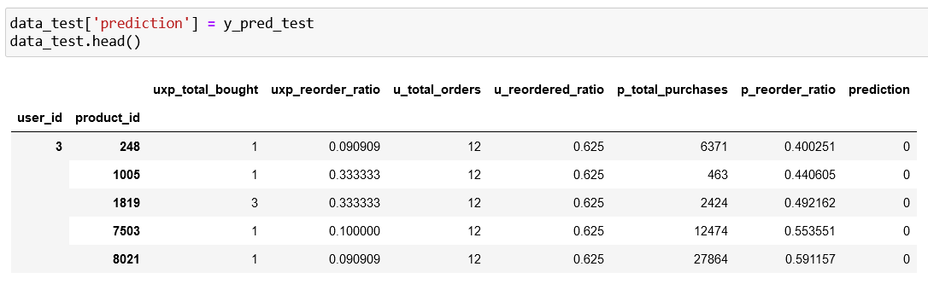
Predict it on test data

Slide 41
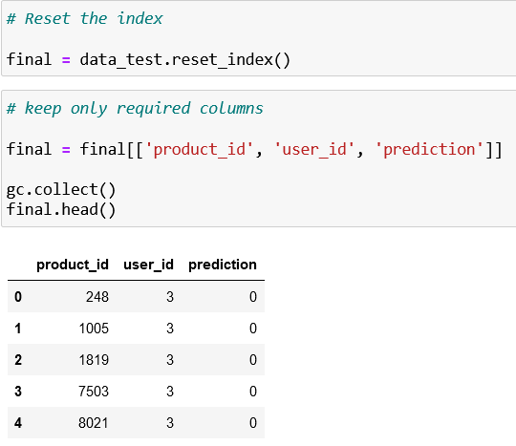
Create final DF with only required columns

Slide 42
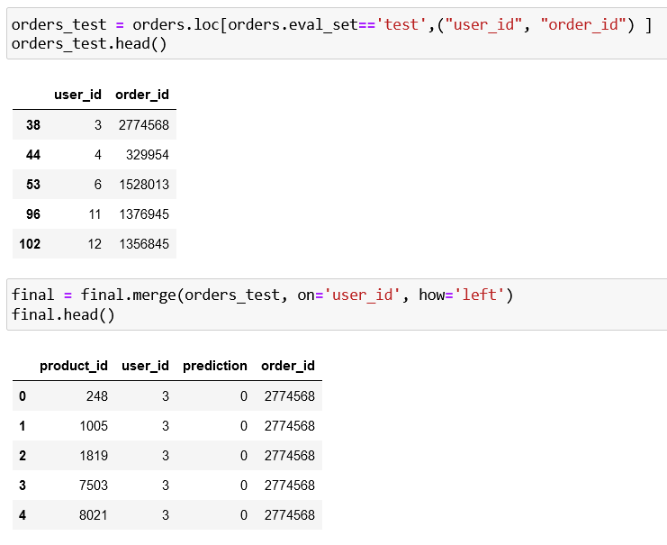
Merge it with orders_test to get order_id

Slide 43
COSINE SIMILARITY

Slide 44
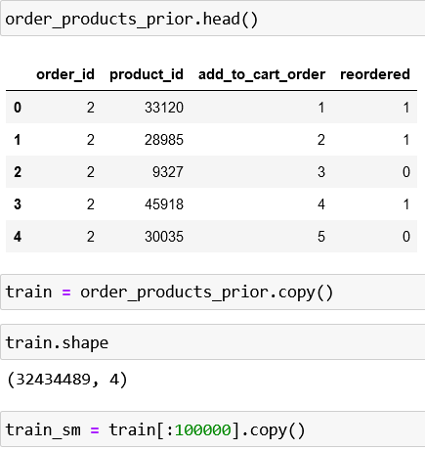
Create a DF train

Slide 45
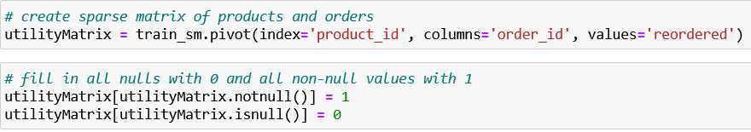
Product similarity (1)

Slide 46
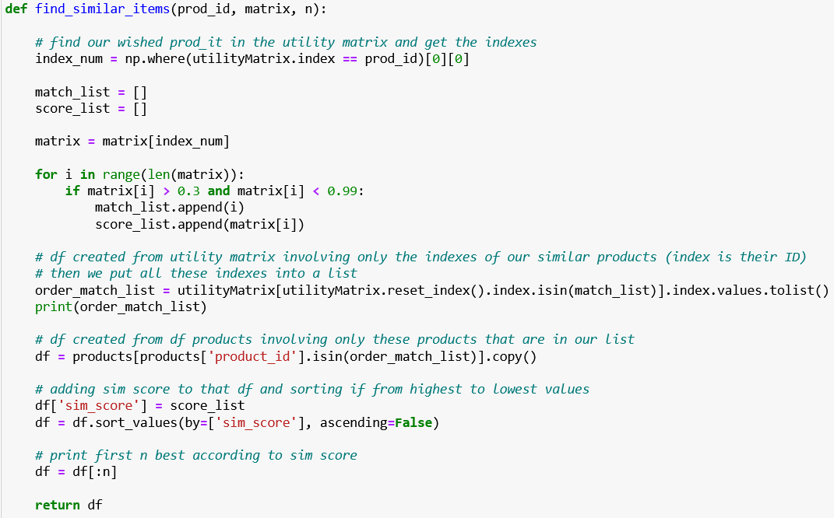
Product similarity (2)

Slide 47
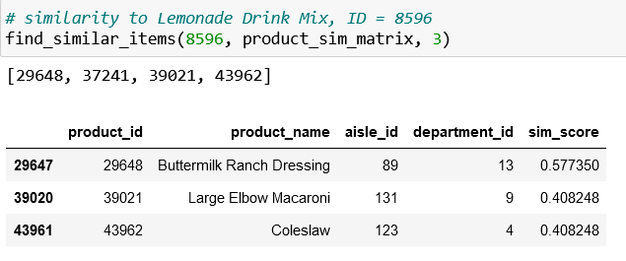
Product similarity (3)

Slide 48
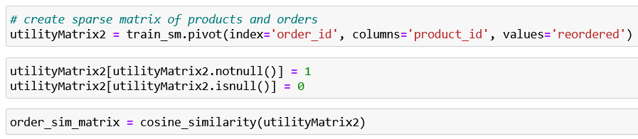
Basket similarity (1)

Slide 49
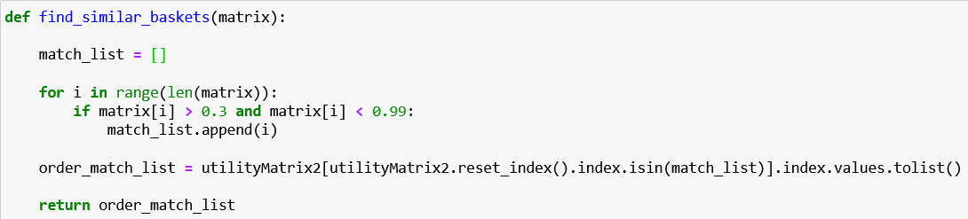
Basket similarity (2)

Slide 50
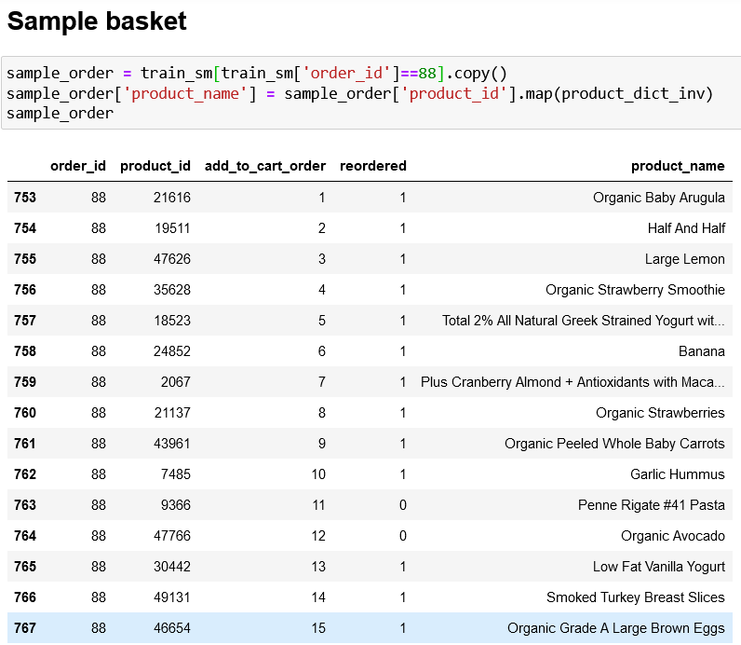
Basket similarity (3)

Slide 51
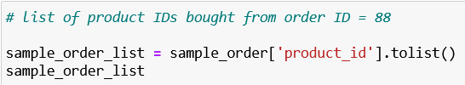
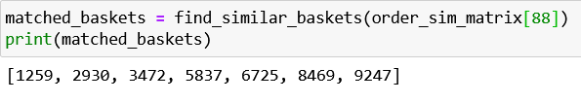
Basket similarity (4)

Slide 52
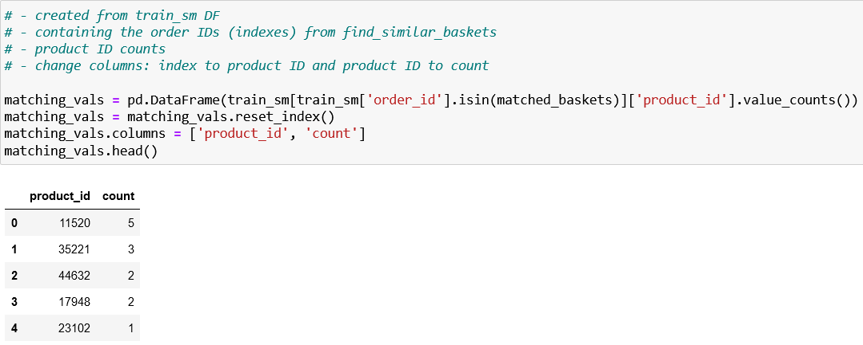
Basket similarity (5)

Slide 53
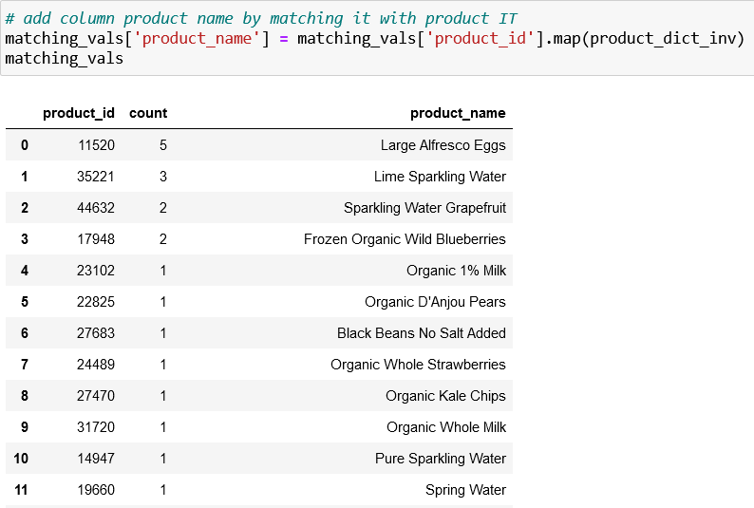
Basket similarity (6)

Slide 54
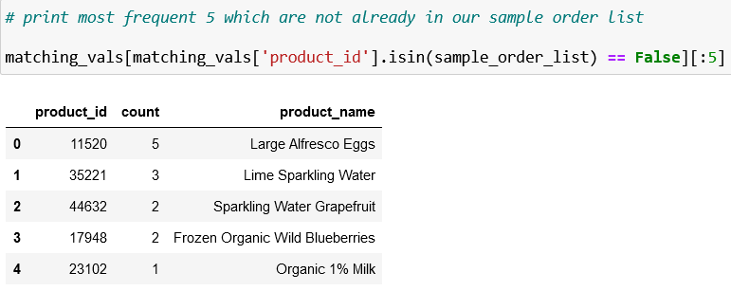
Basket similarity (7)

